Slide 1
Advanced Database Management Systems (CSC-234)
Introduction to MongoDB

Slide 2
MongoDB is an open-source document database that provides high performance, high availability, and automatic scaling.

Slide 3
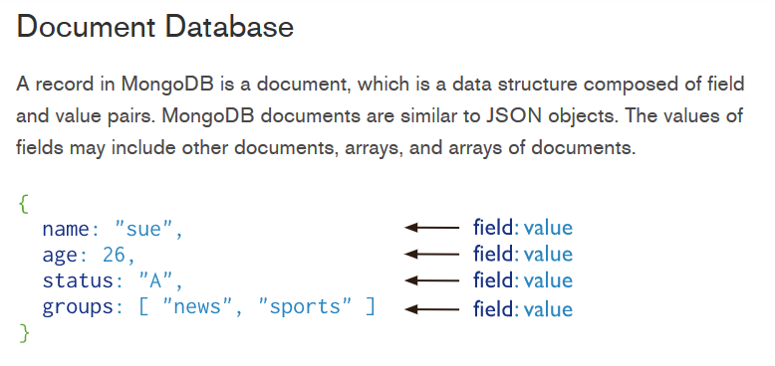

Slide 4
Advantages of using documents
Documents (i.e. objects) correspond to native data types in many programming languages
Embedded documents and arrays reduce need for expensive joins
Dynamic schema supports fluent polymorphism

Slide 5
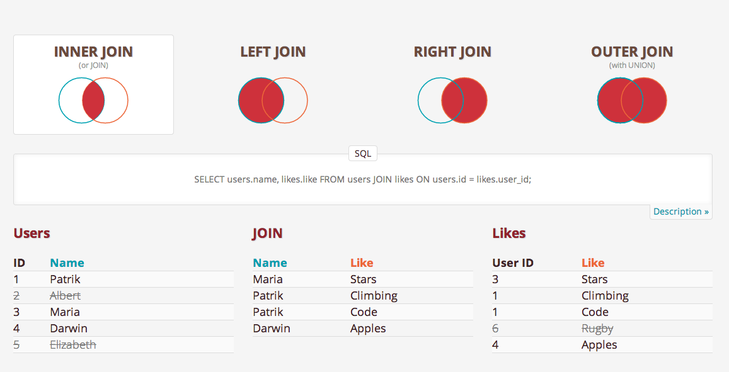
Join

Slide 6
Key features

Slide 7
Key Features: High Performance
MongoDB provides high performance data persistence. In particular,
Support for embedded data models reduces I/O activity on database system.
Indexes support faster queries and can include keys from embedded documents and arrays.

Slide 8
Key Features: Rich Query Language
MongoDB supports a rich query language to support read and write operations (CRUD) as well as:
Data Aggregation
Text Search and Geospatial Queries

Slide 9
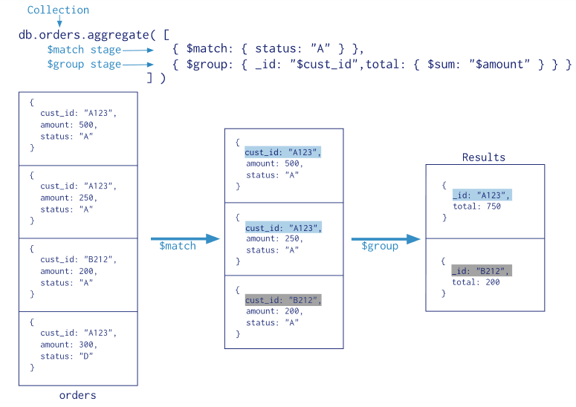
Data Aggregation Pipeline

Slide 10
Key Features: High Availability
MongoDB’s replication facility, called replica set, provides:
automatic failover and
data redundancy
A replica set is a group of MongoDB servers that maintain the same data set, providing redundancy and increasing data availability.

Slide 11
Key Features: Horizontal Scalability
MongoDB provides horizontal scalability as part of its core functionality:
Sharding distributes data across a cluster of machines

Slide 12
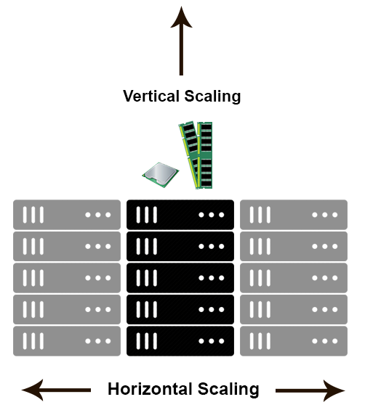

Slide 13
Databases & collections

Slide 14
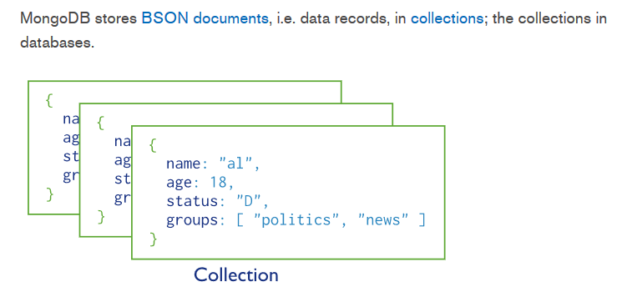

Slide 15
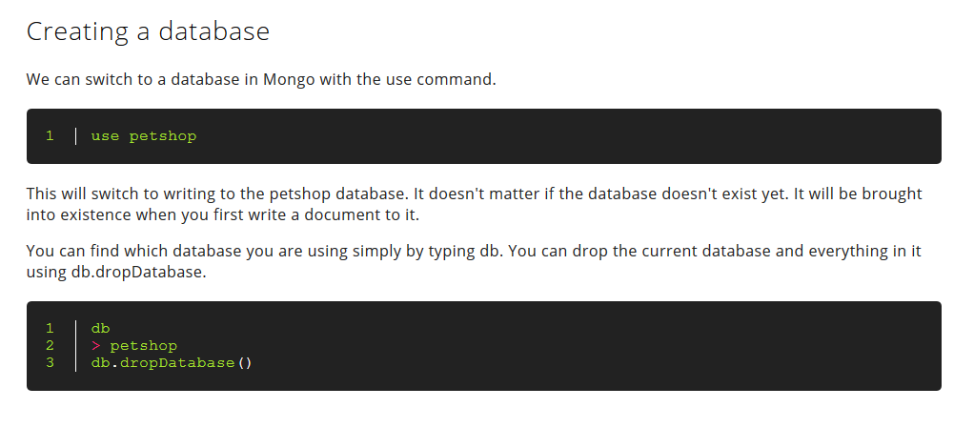
Creating Databases

Slide 16
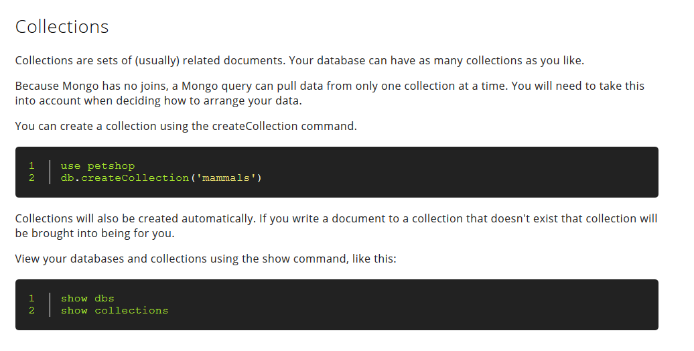
Creating Collections

Slide 17
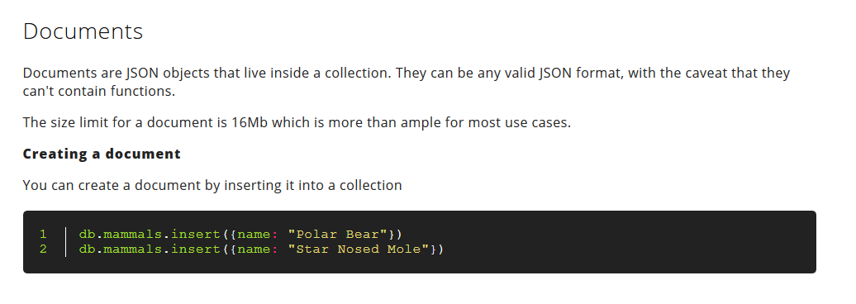
Creating Documents

Slide 18
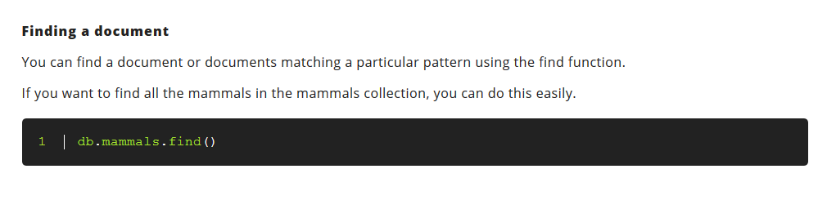

Slide 19
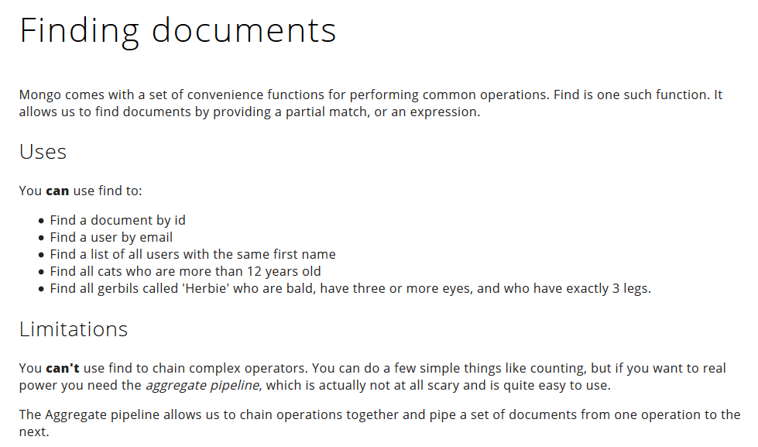

Slide 20
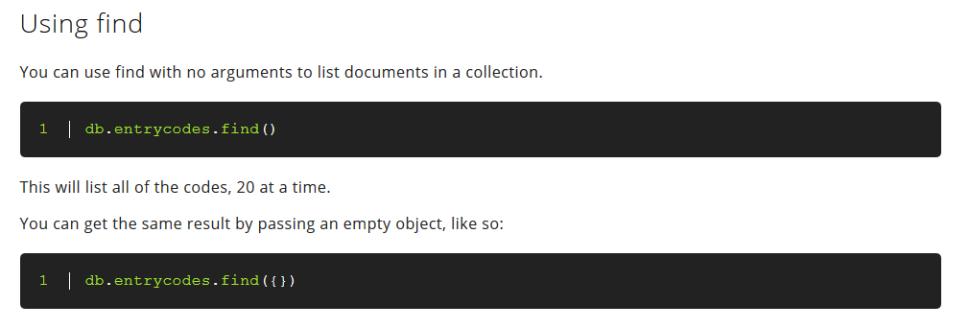

Slide 21
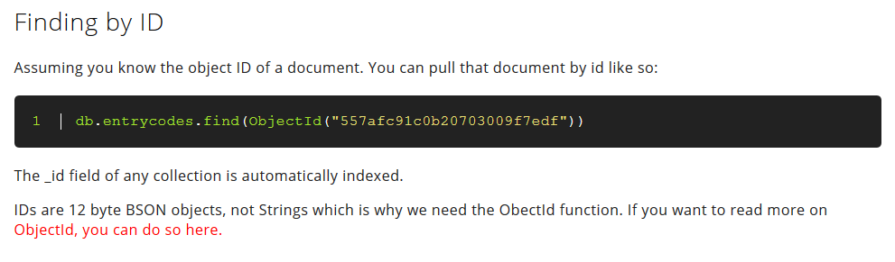

Slide 22
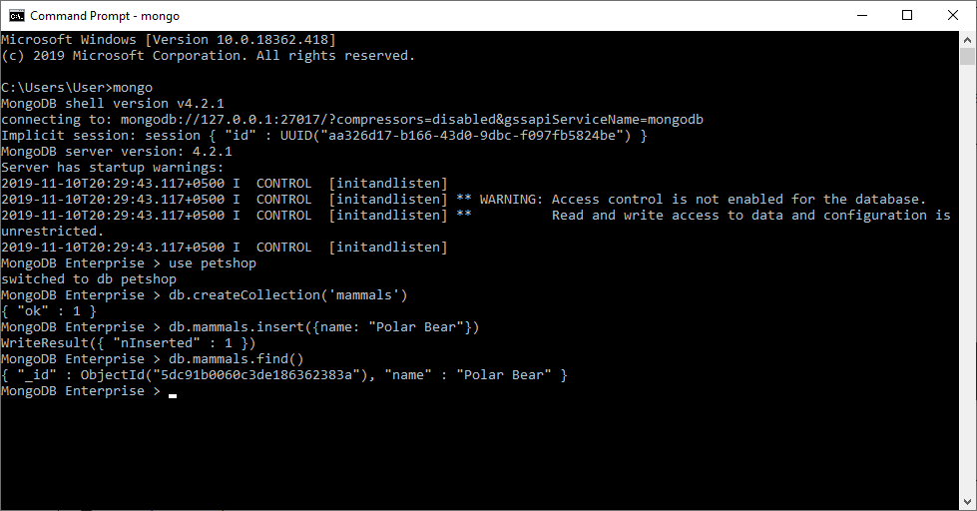

Slide 23
Finding by partial match

Slide 24
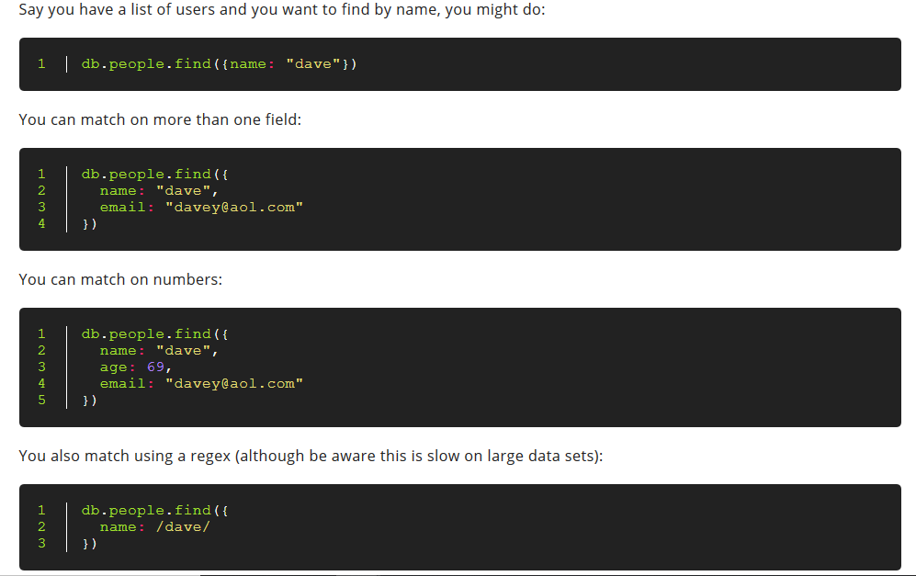

Slide 25
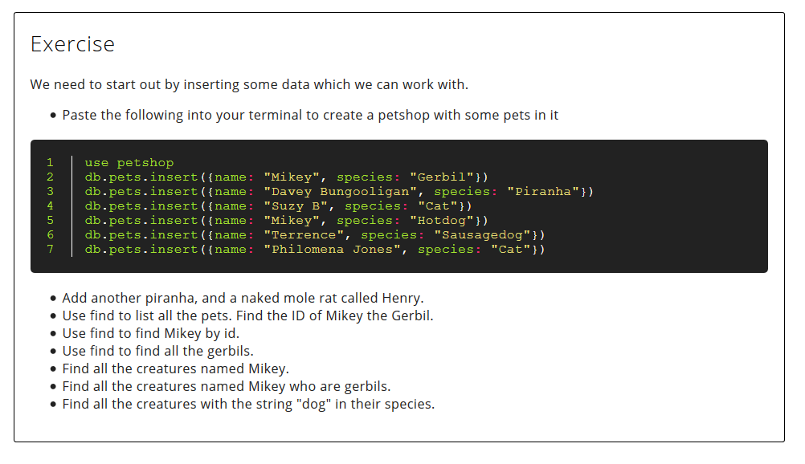

Slide 26
Atlas
Using MongoDB on the cloud

Slide 27
Atlas
Sign up for free Atlas account
Steps available when you sign up
Complete exercise

Slide 28
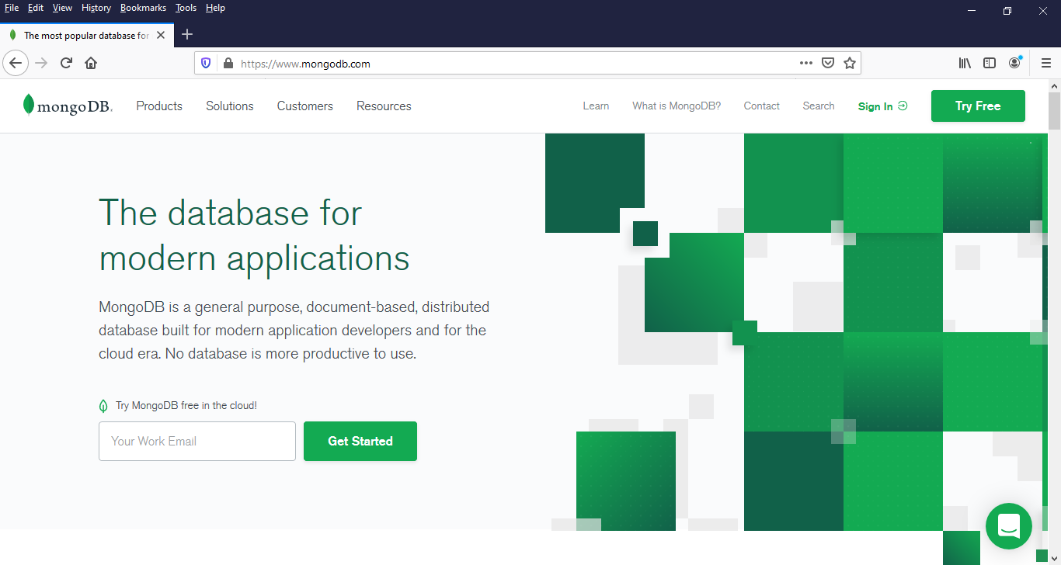

Slide 29
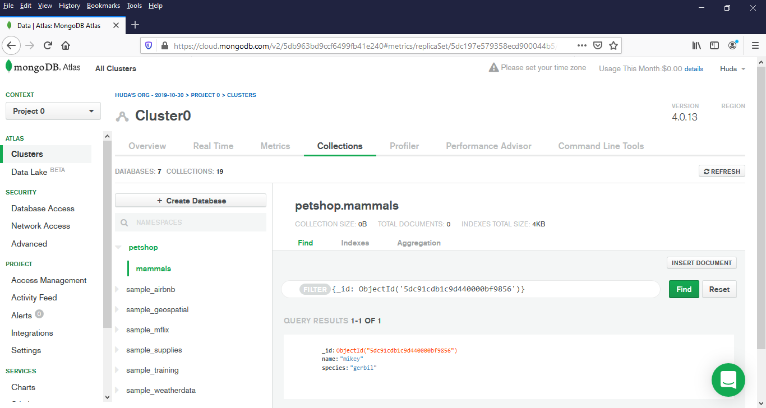

Slide 30
Server & console installation

Slide 31
installation

Slide 32


Slide 33
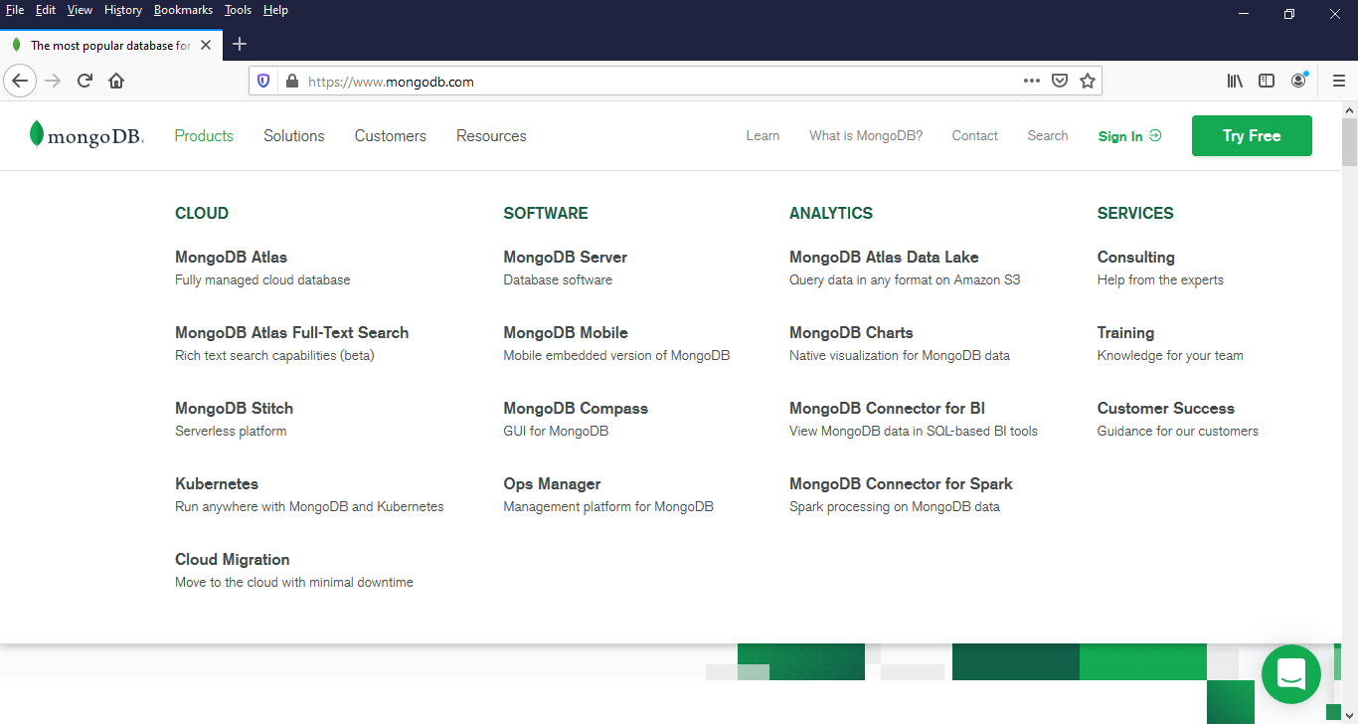

Slide 34
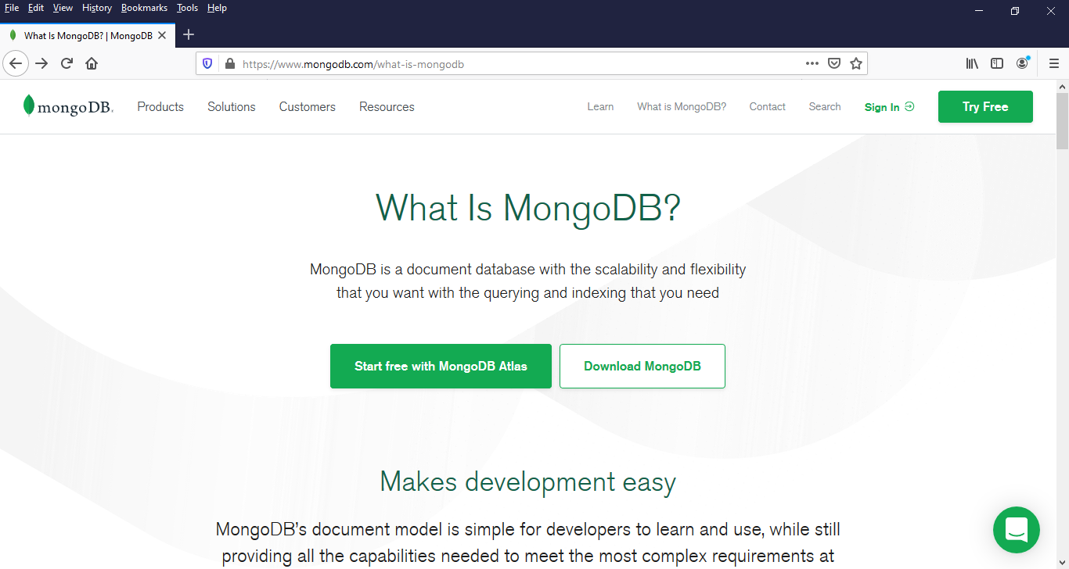

Slide 35
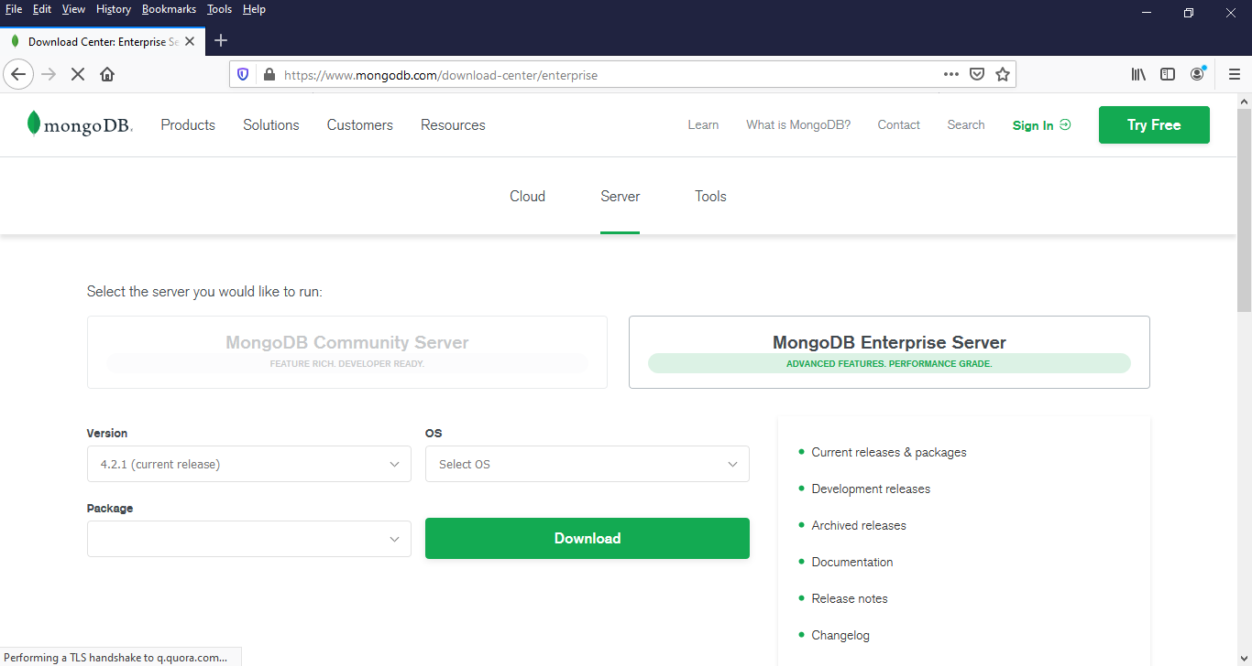
Select complete installation and Compass will be installed automatically.

Slide 36
WAIT FOR INSTALLATION

Slide 37
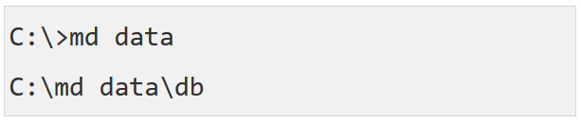
Create data folder
This is the default path expected

Slide 38
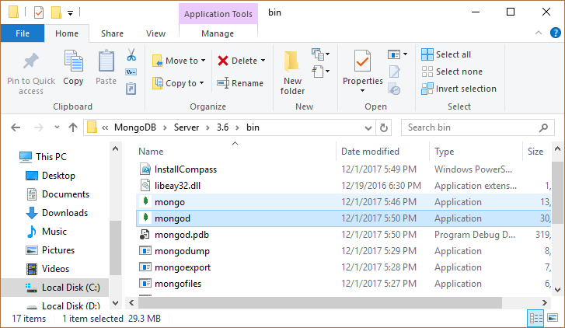

Slide 39
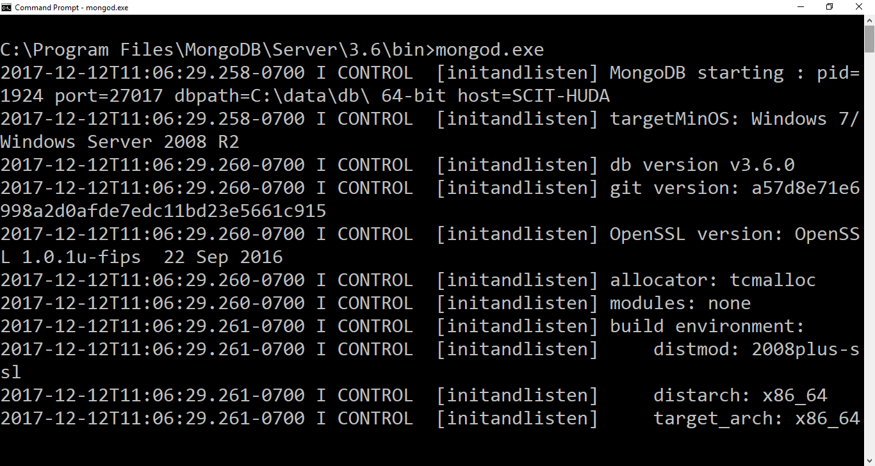
mongod.exe (to run server instance)

Slide 40
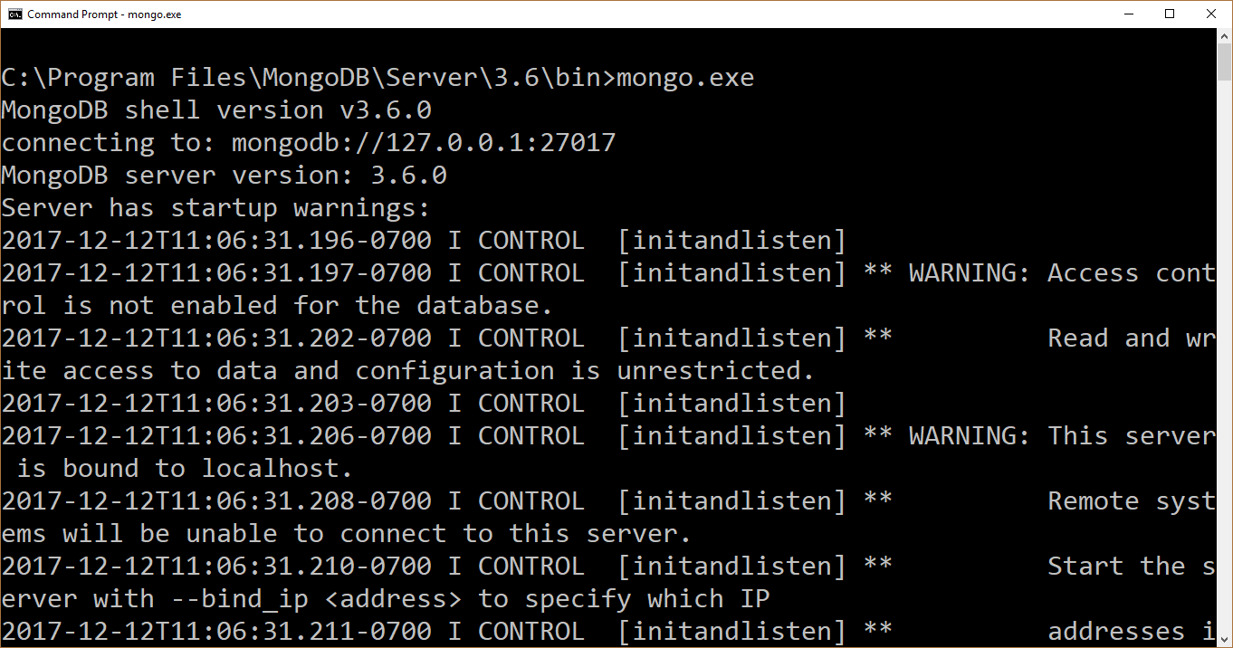
mongo.exe (to connect to server)

Slide 41
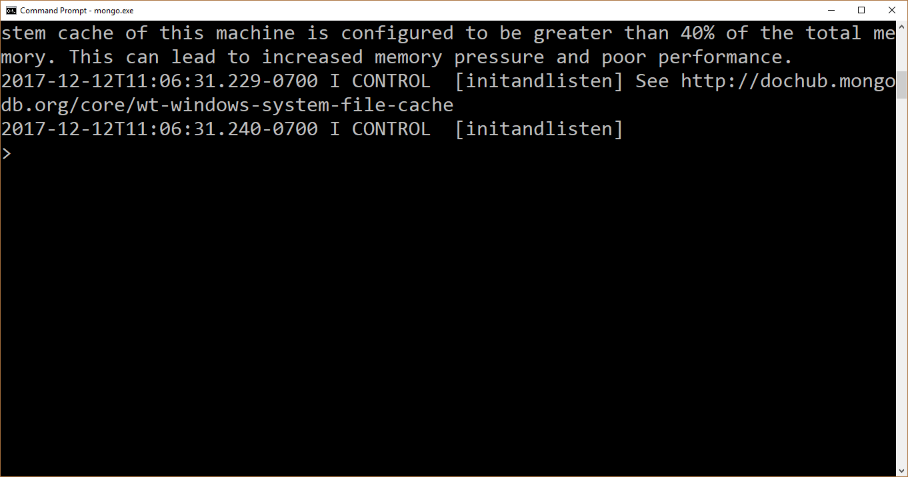
Prompt shows up once connected

Slide 42
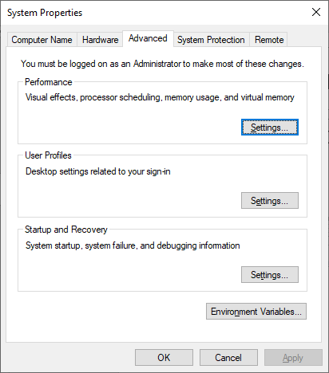
Setting environment variables

Slide 43
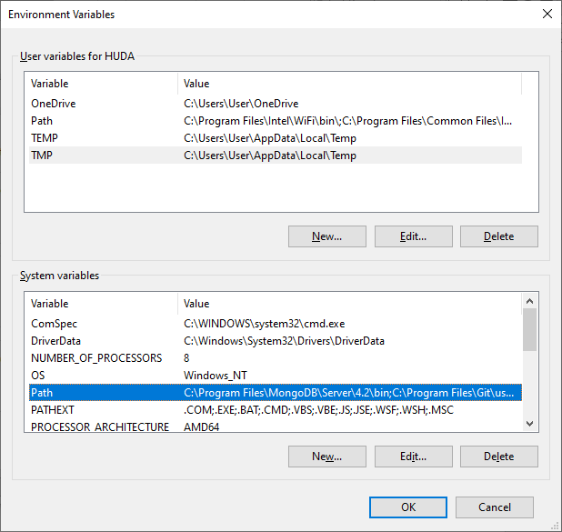

Slide 44
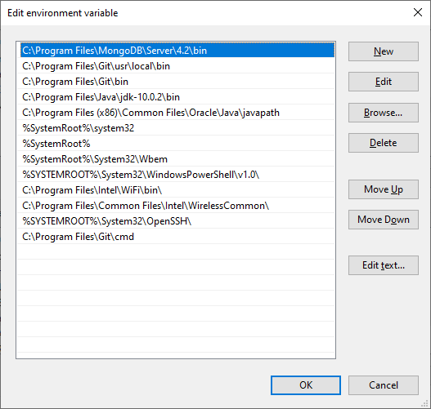
Add this variable to access directly from any location

Slide 45
Server and console installation complete

Slide 46
Note that you have compass installed as well, which will give a similar interface to atlas. Compass can be used to connect to your atlas db or your local db.

Slide 47
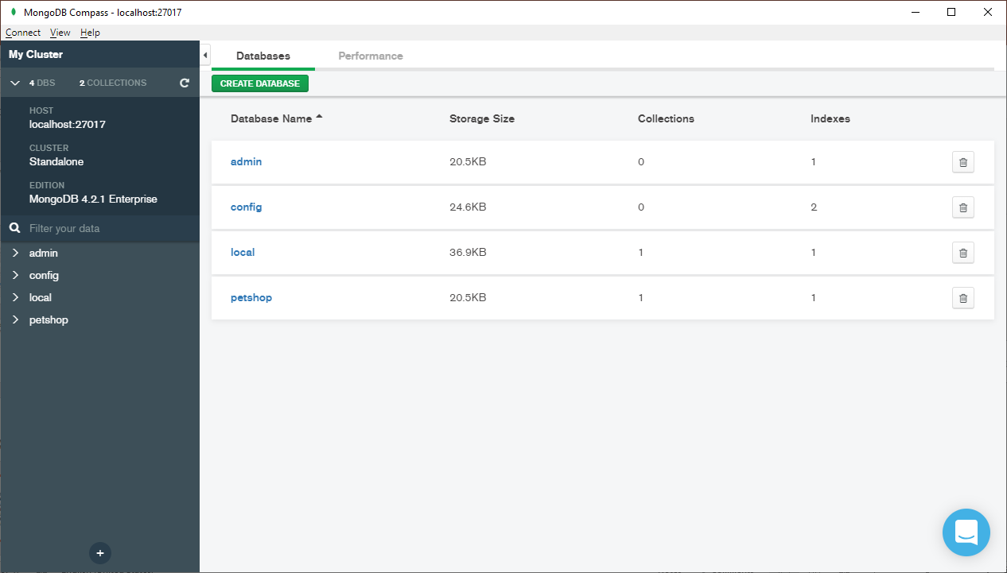
Compass connected to my local server database

Slide 48
Lecture content adapted from https://docs.mongodb.com/manual/ & http://nicholasjohnson.com/mongo/course/workbook/

